Slide 1
Inviol Body Camera Project
Presented By: Julia Borlase, Sai Gamana Putta , Lingze Meng ,Haoge Ming & Ray Crescent Garcia

Slide 2
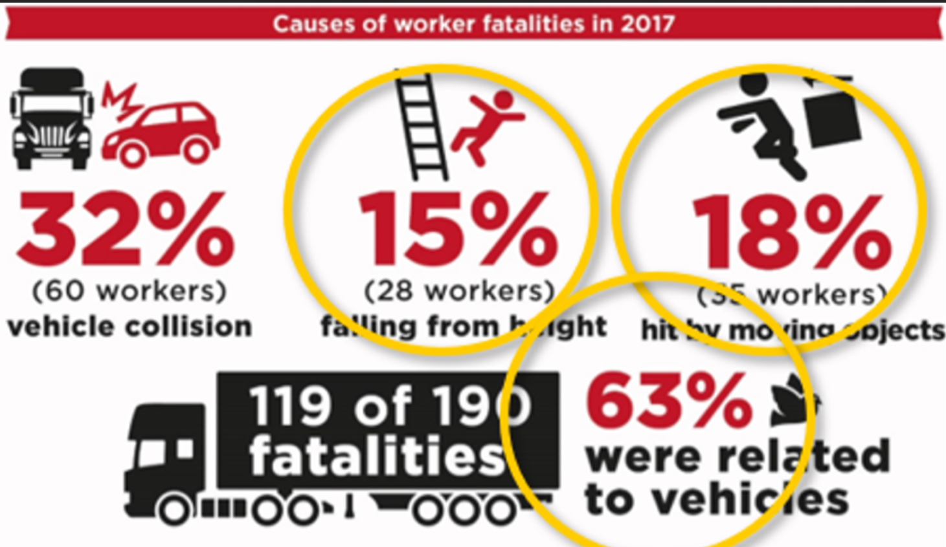
Terms of Reference
Workplace incidents occur worldwide every 7 seconds, costing US $250 billion worldwide annually.
Working with client company, Inviol
Project Aims and Goals: this project aims to detect accidents that include;
Vehicle incidents
Employees falling from objects
Being hit by a moving object(s)
Being hit by falling object(s)
Notes:
Background
Injury in the workplace worldwide occurs every 7 seconds, costing annually $250 billion US dollars.
Within New Zealand, fatalities highlighted in the diagram shown can be avoided by following proper health and safety measures.
We are proposing implementing body-worn cameras in the workplace. These cameras will feedback captured incidents to an API which will feed to a mobile application.
Inviol
We will be working with our client Inviol for this project. Inviol is a startup that is working toward creating safer working environments through implementing cameras in worksites.
Project Aims / Goals
This project aims to detect accidents that include;
Vehicle incidents
Employees falling from objects
Being hit by a moving object(s)
Being hit by a falling object(s)

Slide 3
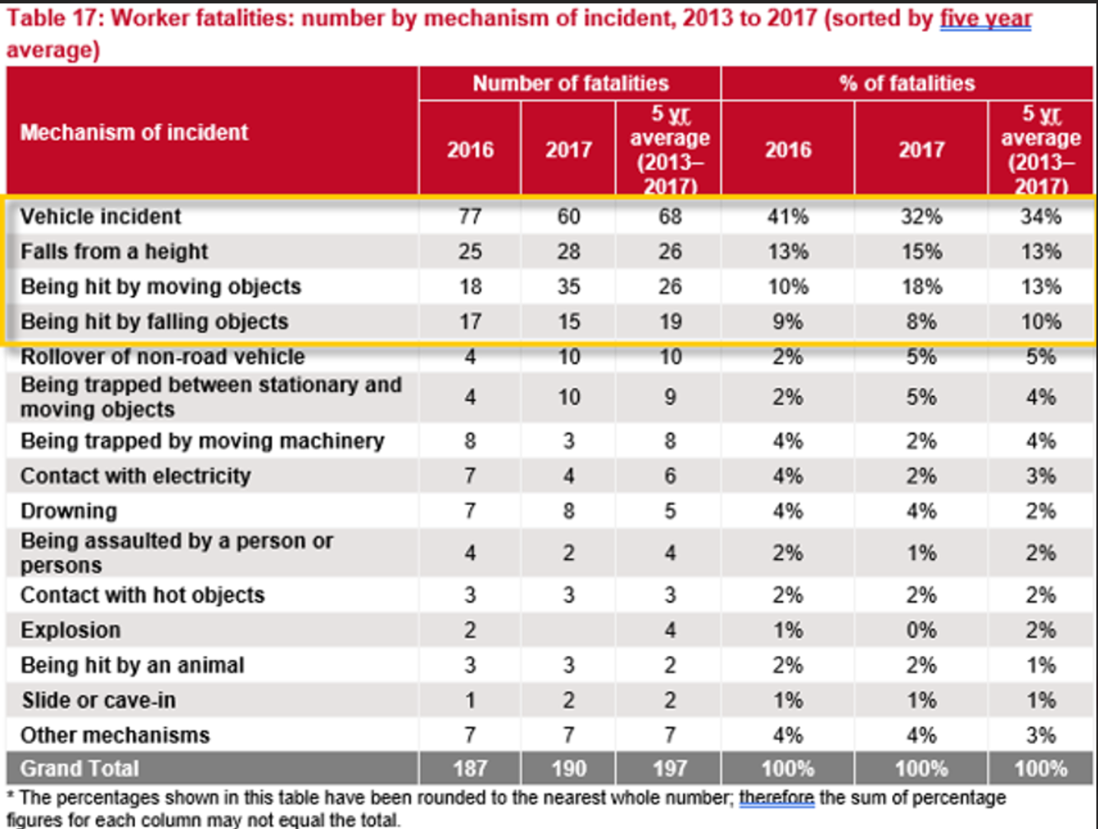
Project Rationale
Project Importance
Previously existing systems
Key Issues identified for this project
Notes:
Project Importance - refer to picture
The importance of this report is to provide a solution to workplace accidents.
Accountability for these accidents tends to fall on the directors. If they aren’t able to prove that proper policies are in place, then they are candidates for charges. The implementation of the body-worn cameras will help to prove what occurred and hold accountable the correct parties.
Existing Systems
Body cameras are currently being used in different workplaces such as security, law enforcement, emergency services, etc.
In comparison to the current cameras that have been deployed in workplaces, our proposed camera will not only provide insight into the safety practices of the employees but will also through the app that we will develop, allow communication between the employees and their managers.
Key Issues
The key issues we will face when finding the a camera for our project will be ensuring that the battery life of the camera is long enough to sustain a full workday, as well as API and WiFi compatible. We will also need to research existing algorithms and systems to better optimize our project so that the API can better detect aggression and other behaviors. These issues were outlined during a brainstorming session with the client.

Slide 4
Project objective and Scope
Project Goal
Scope
Hardware Requirements
1.Camera resolution 2.battery life 3.Camera Size and weight 4.Minimum performance models
5.Onboard and post-processing
Architecture / Design Requirements
1. messages 2.BLOC diagram 3. Detect objects 4. programming language 5. Hardware restraints
6. Open source repos 7. Application
Notes:
Project Goal
The objective of this project is to implement wearable body cameras in workplaces. These cameras will provide feedback through an API to an application. This application will allow employee managers to view potentially dangerous actions taken by their employees while on site. These actions will be viewable through the application, and both the employee and manager will be able to communicate with each other about the incident.
Key stakeholders in this project are Inviol and AUT.
Scope
As a team when the project started, we brainstormed the objectives of the project and the goals that we would work towards. These goals were collated with the client's goals during the brainstorming session held with them. If achieved during the project lifespan would deem the project a success, these objectives are;
A hardware prototype has been selected
The hardware prototype has software installed
The hardware prototype can detect incorrect employee behavior
The software has been created for the hardware prototype
Web/mobile application has been designed for connection with the hardware prototype
To achieve these success criteria we have outlined some hardware and architecture/ design requirements that have been discussed with the client during a brainstorming session
Hardware Requirements
Camera resolution (pixel resolution): The resolution of the camera will need to be high enough quality to detect employees, their surroundings, and both of these objects moving, but also be at a quality that will not drain the battery.
8-hour battery life: the camera will need to be operational for an average of 8 hours, or a full working day. We will need to take into account the amount of battery capacity a camera has when it comes to selecting the camera for the project so that the camera can run for the amount of time specified, as well as have the computing power for WIFI, GPS and the internal processor.
Camera Size and weight: the camera needs to be an appropriate size and weight to be wearable for employees for an entire day, this has been decided with the client to be 500g or less.
Minimum performance models: these models for the hardware could include; jetson, raspberry pi, object detector, position estimation, etc. These are options that were discussed with the client and will be in accompaniment with the camera itself.
Onboard and post-processing, processing will either be done onboard or in post-processing, this will be determined by the requirement of how much battery power the processing takes, and how much more weight onboard processing will require.
Architecture / Design Requirements
Send messages through the internet: the camera will need software that will send messages/ videos from the hardware to the API and in turn the application.
BLOC diagram: code for the hardware and application will follow the guidelines of the BLOC (Business Logic Components) pattern, as requested by the client, following their current coding requirements. This will also ensure that the project is as efficient as it can be. (https://medium.com/@artemsidorenko/bloc-architecture-in-flutter-a-modern-architectural-approach-and-how-we-use-it-at-jimdo-bea143b56d01)
Detect objects: the software that will be installed onto the hardware prototype will need to be able to have an object detection element to identify the employee's actions and views.
Framework/programming language: these will be required for the application and the hardware prototype.
Hardware restraints: described above in the hardware requirements, these requirements will determine some of the software that will need to be used, and what programs are runnable on the devices.
Open source repos: as advised by the client, we will resource open source repositories for model training.
Application: the application will require; product design, UX design, and graphic design.
Derived from our definition of success and the hardware and architecture/design requirements stated above, our project deliverables are formed. These deliverables consist of;
Wearable body cameras
Software to be installed on the cameras
API software (either modify the current API or the new one)
Mobile / Web Application
As seen in the requirements stated in the scope, our team will need several resources to complete this project defined by our definition of success.

Slide 5
Project methodology
Planning
Learning
Project work
Notes:
Planning
Our main goal as a team was to take a real-world topic and conduct an in-depth investigation focusing on the type of accidents that usually occur around trucks in order to assist inviol in removing complacency from workplaces thus making workplaces safer.
As a team, we will be working with the clients from the very beginning of the project to brainstorm and discuss the appropriate software and hardware to use for the project that will help create a safer workplace with body worn cameras
We receive information and instructions from our clients on how to set up a body worn camera that connects to an API and feeds data to a mobile application that is assessed by site managers who can view accidental actions by the employees.
While on the process of creating the product for inviol as a whole team we will be composing a draft proposal noting down all the requirements for the project which is signed individually to all the team members to be completed.
Once the draft proposal is completed and handed over to receive feedback. We will contact our client and plan meeting in order to start with creating our product for the company as a part of our main project.
Identifying the features that our camera needs to detect would be the first step in creating a safer work environment for employees.This would include Location, positioning rules that enables to have wifi, Bluetooth, GPS which detects in advance regarding the accidents that can occur. This will also include a behavior of a human that can detect any unsafe behavior such as jumping, Smoking, bad posture that can cause injury.
Once the necessary detection is completed, Hardware requirements need to be noted down. This would include Camera resolution (pixel resolution), 8 hour battery life: ensuring that the camera has plenty of power to run for as long as stated, as well as be equipped with WIFI, GPS, and an internal processor, Camera size and weight: employees need to be able to wear the camera for a long time, Minimum performance model, Onboard processing or post processing, depending on how much battery power the processing takes and how much weight onboard processing requires.
The next step would be setting up Architecture / Design Requirements for sending messages from the hardware to the API, and from there to the application, a BLOC diagram will be generated showing the hardware and application code in accordance with the BLOC (Business Logic Components) pattern, as requested by the client, Object detection feature the software that will be installed onto the hardware prototype should be able to detect employee actions, Framework / programming language to be installed, Hardware limitations: described in the hardware requirements.
The next step of planning would be creating open source repos: a recommendation from the client will allow us to use open source repositories for model training. The application will require product design, UX design, and graphic design which will be inbuilt and designed on the body worn camera training mode.
The most important planning step is the building process of the model camera product with having all the hardware and Architecture / Design Requirements.This includes AGILe, Sprints, Azure Devops, GIT Repos, Kanban/Trello Boards, Prioritization, Break Down Work into User Stories, Workload, Estimated Time Of Completion, Description of the model created, Team Member(s) Assigned to User Story, Exceptions/Criteria, Set Sprint Goals of completing the product on time.
Testing would be a very crucial step that involves the client to test the product we have created and make sure all the application related to the product and up and running which will help with creating the workplace safer for the employees
Passing all these steps we have planned would create a successful body worn camera model which will complete our project work and helps creating a safer workplace for the employees and causing less accidents at work.
Learning
Learning is a very essential part of the project in every step to lead to a great successful teamwork.Our teams main focus was to learn to develop body worn cameras implementing in the workplace. An API will feed the video data to a mobile application, which site managers can use to access the feed. By using such cameras, you will be able to detect items such as employees wearing the incorrect clothing, jumping off and over hazardous surfaces, employees working in potentially dangerous areas, incorrect handling of equipment, etc.In this process we will be learning how cameras work how the API will feed the video data to a mobile application. First we will mainly be focusing on creating the camera with hardware, software and Architecture / Design Requirements. We will be learning to create online website and mobile application through coding language that allows to use API model. We will also be learning the best fit camera for the creation accordance with its weight, size, battery life, resolution of picturization. Will be learning to install software in the body worn cameras which would have included features such a wifi, bluetooth, GPS. Product design, UX design, and graphic design are to be thought by the client to us. Most importantly will be learning Block diagram of the body worn camera code for the hardware and application will follow the guidelines of the BLOC (Business Logic Components) pattern, as requested by the client.
Project work
Our main project work is based on working with our client Inviol for this project. Inviol is a New Zealand based startup developing company AI-driven hardware & software solutions to assist in detecting workplace hazards as well as implementing workplace health & safety strategies to prevent accidents from occuring. Worksite cameras are being installed in an effort to weed out complacency surrounding policies that are known to keep employees safe around the workplace and decrease the possibility of accidents. It takes a considerable amount of effort for agencies to get body cameras into place. Implementing body-worn cameras has some challenges, including monetary and personnel resources. Keeping all this in mind our team has collaborated with Inviol for this project work of creating a body worn camera product to provide employees with the feeling of safety at work with the camera serving as a safeguard against accidents occurring with members of the public and providing evidence should an incident occur.

Slide 6
Team roles and expected work behaviour & practice
What we expect from each other
Team Contract
Communication
Seeking Assistance
Regular Team Meetings
Interpersonal Disputes/Conflict
Team Leadership
Problem Solving
Team Roles
Notes:
Expectations Set
We have created a contract as a team so that we would know what is expected of us and each other when working together. The terms of the contract focus on values such as good communication, proper conflict handling and professionalism. This ensures that our progress throughout the project will be smooth as long as we follow the terms that we all agreed on.
Team Contract
Communication with team members: team members will speak politely and respect each other, will not lower their voice or their opinions. All the team members will be positive in recognizing and thanking one another's thoughts on the team project and will not be speaking down to each other. Team members should acknowledge and thank each other for the contributions they make for the team project.
Seeking help from team members: Be honest with ourselves when we are stuck and accept help from other team members. Allow members to provide assistance when we are stuck.
Team meetings: All team members must listen attentively without interjecting while an individual team member is sharing their thoughts and ideas. During conversations, there should be no disagreements. All team members must attend all the meetings and adhere to the rules that govern effective meetings. Attending meetings prepared by members of the meeting group should be punctual.
Interpersonal Disputes within Team Members: Team members will ensure they all understand what to communicate and when. Any complaints regarding other team members will be addressed first within the team, if a solution can not be found, we will communicate our issues with the teacher for assistance.
Team leadership: We are a team of 5 members and treat all team members equally hence leadership will rotate weekly as per the work done that has been provided to the individual by the group.
Team problem solving, conflict resolution and decision making: disputes among teammates will be handled directly with the disputants. It is important to not hold grudges against one another and work together as a group leading to achieve success.

Slide 7
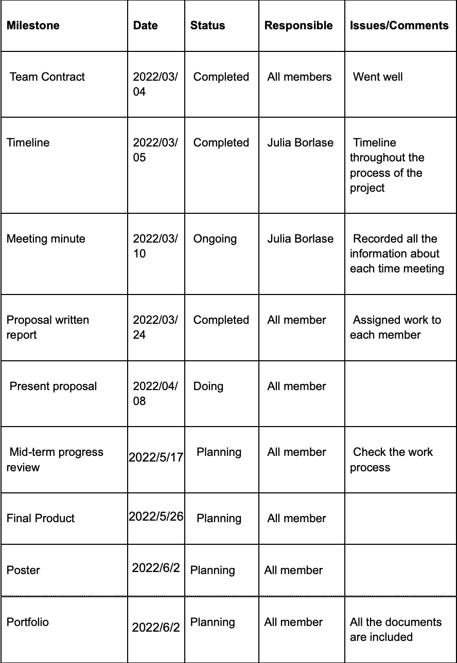
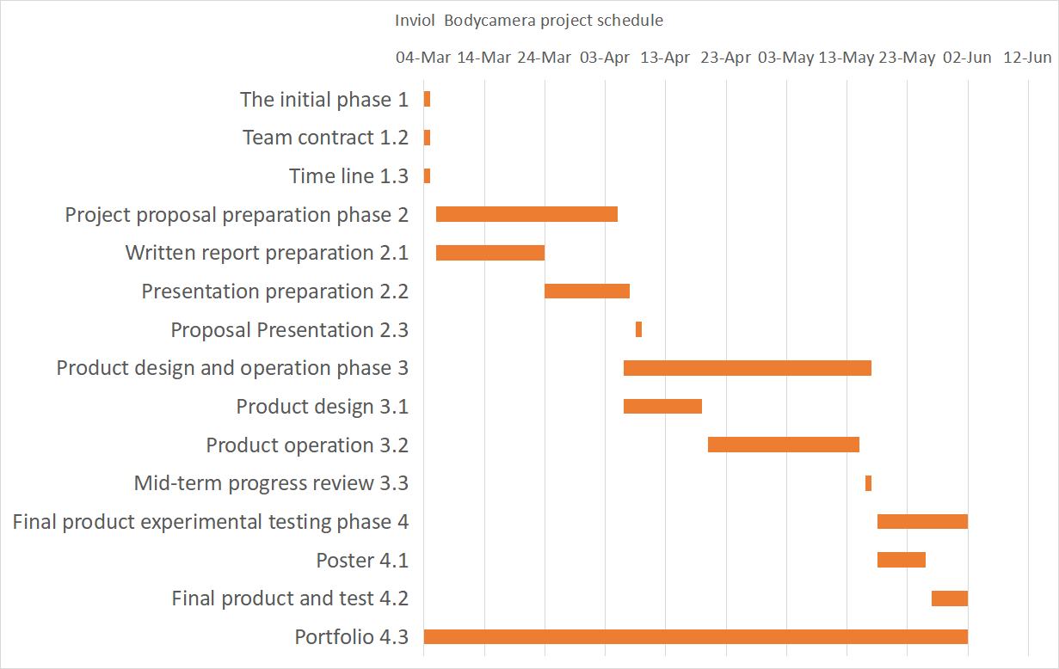
Project Schedule & Milestone Report
Notes:
Project Schedule:
1: Initial phase (04 March - 05 March)
2: Proposal preparation phase (05 March - 07 April)
3: Product design and operation phase (08 April - 17 May)
4: Final product experimental testing phase (17 May - 02 June)
Total duration: 04 March - 2 June (90 days)
Milestone report:
All milestone tasks and estimated completion time are all included in the Gantt chart.
Speak draft:
we plan to divide the entire process into four phases, which is initial phase, proposal preparation phase, product design and operation phase, and final product experimental testing phase. All the AUT assignment and estimated completion time are all included in this chart as well. From now on, we have already come to the end of second phase. We have previously identified the project theme and purpose with our client, and developed a team contract to ensure the effectiveness of teamwork.After that, we will start to compose more detail about our project to make our product into reality. During the ongoing development of the project we will keep our client informed of our progress and make algorithm improvements based on the feedback. In the Week 12 mid-term review, We plan to complete the most of our work, summarize our work and report the progress. After mid-term review we will test our final product and find problems and solve them during the testing process. If the progress of the entire project can be carried out strictly according to the schedule, the entire project will take a total of 90 days, and finally the entire project will be completed on the second day of June this year.

Slide 8
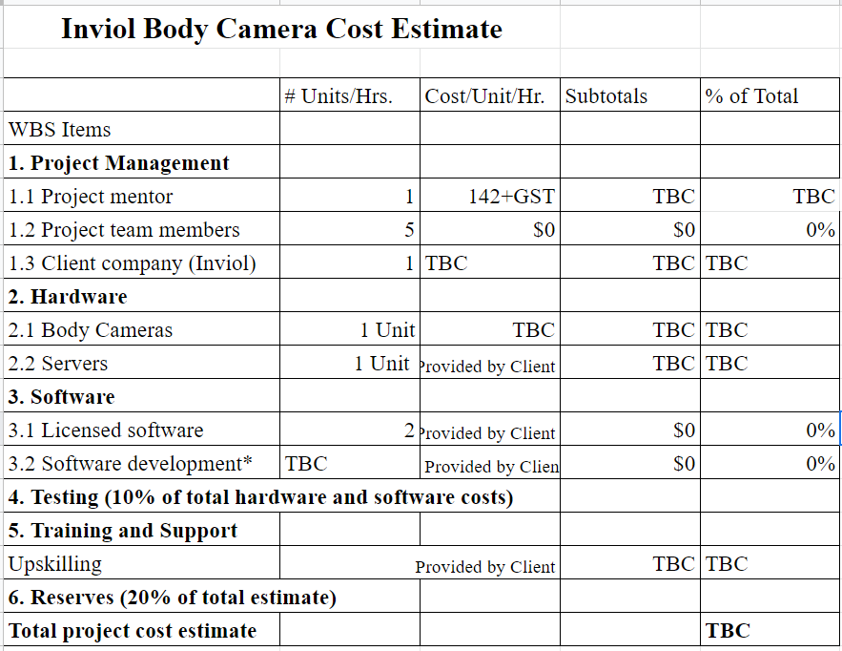
Estimate costs
Notes:
Costs
In the table above is the outline for the cost estimate. Due to research needing to be completed on the hardware to be used, the total cost estimate has not yet been calculate. The client is providing the software for this project.

Slide 9
References
(n.d.). Data Centre | WorkSafe. https://data.worksafe.govt.nz/
(n.d.). Inviol. https://www.inviol.co.nz/
Body worn cameras and lone working. (2022, February 18). Peoplesafe. https://peoplesafe.co.uk/blogs/body-worn-cameras-and-lone-working/
Sidorenko, A. (2018, September 25). Bloc architecture in flutter: A modern architectural approach and how we use it at Jimdo. Medium. https://medium.com/@artemsidorenko/bloc-architecture-in-flutter-a-modern-architectural-approach-and-how-we-use-it-at-jimdo-bea143b56d01

